Slide 1
Equilibria
7.1 Chemical equilibria: Reversible reactions and dynamic equilibrium
7.2 Brønsted–Lowry theory of acids and bases

Slide 2
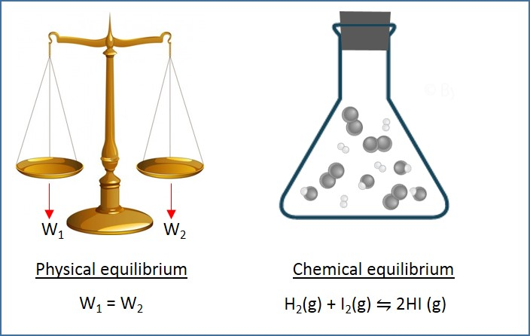
Introduction
When two objects have the same mass, they are said to be in physical equilibrium.
Chemical equilibrium deals with reversible reactions.
When the rate of forward reaction is equal to the rate of backward reaction in a closed container, the system is said to be in dynamic equilibrium.
Equilibrium

Slide 3
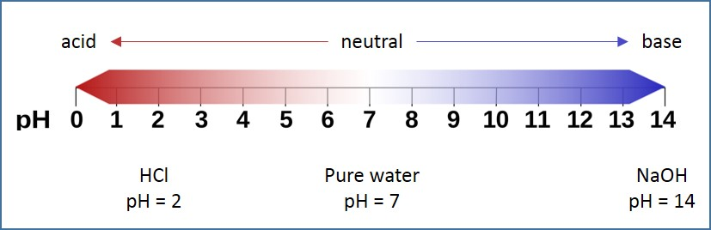
Introduction
Weak acids do not dissociate in aqueous solutions. Strong acids dissociate completely in aqueous solution.
Buffers are solution whose pH value does not change with small addition of acid or base.
Calculation of pH values of strong acid, weak acid, strong base and buffer will be discussed.
Neutralisation and various types of indicators used for different scenarios will be discussed.
pH range

Slide 4
Reversible reactions
A reaction in which the products can react to form the original reactants is called a reversible reaction.
For example: Hydrated copper sulphate which is blue in colour is heated to form anhydrous copper sulphate which is white in colour. This is the forward reaction.
The anhydrous copper sulphate dissolves in water to form hydrated copper sulphate. This is the backward reaction.
Reversible reaction: CuSO₄.5H₂O(s) ⇋ CuSO₄ (s) +5H₂O (l)
Forward reaction: CuSO₄.5H₂O(s) → CuSO₄ (s) +5H₂O (l)
Backward reaction: CuSO₄ (s) +5H₂O (l) → CuSO₄.5H₂O(s)

Slide 5
Reversible reactions
In some chemical reactions, the forward and backward reactions take place at the same time. For example: reaction between hydrogen and iodine in a closed container at 673 K.
H₂(g) + I₂(g) ⇋ 2HI (g)
The hydrogen and iodine molecules combine to form hydrogen iodide molecules. At the same time hydrogen iodide molecules break down to form hydrogen and iodine molecules.
This type of reversible reaction is called equilibrium reactions.

Slide 6
Dynamic equilibrium
A condition called dynamic equilibrium is achieved if the rate of forward reaction is equal to the rate of backward reaction and the concentrations of reactants and products do not change.
In this case, the rate of formation of hydrogen iodide and the rate of decomposition of hydrogen iodide is equal.
Reaction between hydrogen and iodine in a closed container at 673 K.
H₂(g) + I₂(g) ⇋ 2HI (g)

Slide 7
Le Chatelier’s principle
The equilibrium is disturbed by factors such as change in concentration of reactants or products, changes in pressure and temperature.
In such cases, when the concentration of products increases with respect to that of reactants, we say that the equilibrium has shifted to the right.
Alternatively, when the concentration of products decreases with respect to that of reactants, we say that the equilibrium has shifted to the left.
Le Chatlelier’s principle states that if one or more factors affect the position of the equilibrium, the position of equilibrium shifts in the direction that reduces the change.

Slide 8
Le Chatelier’s principle: Effect of change in concentration of reactants or products
When the concentration of one or more reactants increases, the equilibrium of the system is disturbed. The system tries to oppose this change by shifting the equilibrium to the right, i.e., forming more products until the equilibrium is reached.
When the concentration of one or more products increases, the equilibrium of the system is disturbed. The system tries to oppose this change by shifting the equilibrium to the left, i.e., forming more reactants until the equilibrium is reached.

Slide 9
Le Chatelier’s principle: Effect of change in concentration of reactants or products
Consider the following reaction,
CH₃COOH (l) + C₂H₅OH (l) ⇋ CH₃COOC₂H₅ (l) + H₂O (l)
When CH₃COOH is added, the concentration of CH₃COOH increases, the equilibrium shifts to right forming more products until the equilibrium is restored.
When H₂O is added, the concentration of H₂O increases, the equilibrium shifts to left forming more reactants until the equilibrium is restored.
When CH₃COOC₂H₅ is removed, the concentration of CH₃COOC₂H₅ reduces, the equilibrium shifts to right to produce more CH₃COOC₂H₅ and H₂O until the equilibrium is restored.

Slide 10
Le Chatelier’s principle: Effect of change in pressure
Change in pressure disturbs the equilibrium when at least one of reactant or product is in gaseous state. This is because solids and liquids are not compressible, but gases are compressible.
A high pressure for gas means more particles in a given volume, that is, a higher concentration. A low pressure for gas means less particles in a given volume, that is, lower concentration.
When pressure increases at constant temperature, the molecules are compressed. The position of equilibrium shifts to oppose this change. It shifts in a direction to reduce the number of molecules.

Slide 11
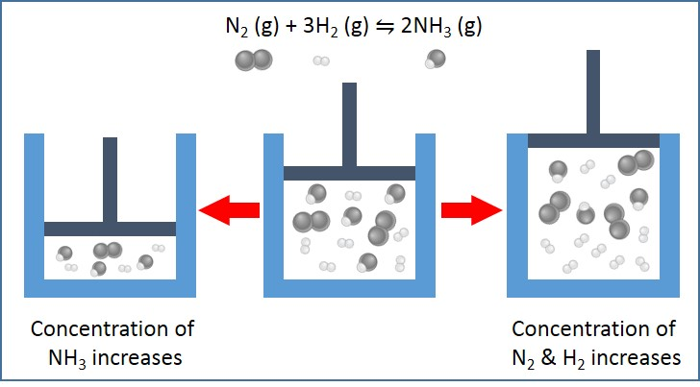
Le Chatelier’s principle: Effect of change in pressure
Consider the following reaction,
N₂ (g) + 3H₂ (g) ⇋ 2NH₃ (g)
When the pressure increases at constant temperature, the equilibrium shifts to the right to oppose the change. The reactant side has 4 moles, whereas the product side has only 2 moles. More NH₃ molecules are formed.
When the pressure decreases at constant temperature, the equilibrium shifts to the left to oppose the change. More gaseous molecules are formed to increase the pressure. Hence, more nitrogen and hydrogen molecules are formed.
Effect of pressure in equilibrium

Slide 12
Le Chatelier’s principle: Effect of change in pressure
If there are equal number of molecules of gas on each side of a chemical reaction, the position of the equilibrium remains unchanged with changes in pressure.

Slide 13
Le Chatelier’s principle: Effect of change in temperature
Temperature affects the equilibrium concentration of a reaction.
When temperature increases, the reaction that opposes this change takes place.
The change in position of equilibrium due to temperature depends on whether the reaction is exothermic or endothermic.

Slide 14
Le Chatelier’s principle: Effect of change in temperature
Consider the exothermic reaction,
2SO₂ (g) + O₂ (g) ⇋ 2SO₃ (g)
When temperature increases, the position of equilibrium shifts towards the reactants. The concentration of SO₂ and O₂ increases.
When temperature decreases, the position of equilibrium shifts towards the product. The concentration of SO₃ increases.

Slide 15
Le Chatelier’s principle: Effect of change in temperature
Consider the endothermic reaction,
H₂ (g) + CO₂ (g) ⇋ H₂O(g) + CO(g)
When temperature increases, the position of equilibrium shifts towards the products. The concentration of H₂O and CO increases.
When temperature decreases, the position of equilibrium shifts towards the reactants. The concentration of H₂ and CO₂ increases.

Slide 16
Le Chatelier’s principle: Effect of catalyst
Catalyst increases the rate of reaction.
Catalyst reduces the time taken to achieve the equilibrium.
But, once the equilibrium is reached, a catalyst does not have any effect on the position of equilibrium.
This is because catalyst speeds up both the forward and reverse reactions equally.

Slide 17
Equilibria in industrial applications
Equilibria is important for the reaction to be faster yet economically beneficial.
Production of ammonia
Ammonia is synthesised using Haber’s process and the reaction is,
N₂ (g) + 3H₂ (g) ⇋ 2NH₃ (g) ΔH_{r}=-92 kJ/mol
Effect of temperature: This reaction is exothermic and hence, decreasing temperature would favour the forward reaction. But, decreasing the temperature also decreases the rate of reaction. A temperature of 723 K is chosen to be the optimum temperature for this reaction.

Slide 18
Equilibria in industrial applications
Equilibria is important for the reaction to be faster yet economically beneficial.
Production of ammonia
Ammonia is synthesised using Haber’s process and the reaction is,
N₂ (g) + 3H₂ (g) ⇋ 2NH₃ (g) ΔH_{r}=-92 kJ/mol
Effect of pressure: In this reaction, ammonia production increases by increase in pressure. Increasing the pressure is not economy beneficial after a certain extent because of the energy costs of pumps and equipment. A pressure of 200 atm is chosen for this reaction.
This reaction takes place in the presence of iron catalyst.

Slide 19
Equilibria in industrial applications
Production of sulphuric acid
Sulphuric acid is synthesised using Contact process and the reaction is,
2SO₂ (g) + O₂ (g) ⇋ 2SO₃ (g) ΔH_{r}=-197 kJ/mol
Effect of temperature: This reaction is exothermic and hence, decreasing temperature would favour the forward reaction. But, decreasing the temperature also decreases the rate of reaction. A temperature of 723 K is chosen to be the optimum temperature for this reaction.

Slide 20
Equilibria in industrial applications
Production of sulphuric acid
Sulphuric acid is synthesised using Contact process and the reaction is,
2SO₂ (g) + O₂ (g) ⇋ 2SO₃ (g) ΔH_{r}=-197 kJ/mol
Effect of pressure: In this reaction, sulphuric trioxide production increases by increase in pressure. Increasing the pressure is not economy beneficial after a certain extent because of the energy costs of pumps and equipment. A pressure of 1-2 atm is chosen for this reaction.
This reaction takes place in the presence of vanadium pentoxide (V₂O₅) catalyst.

Slide 21
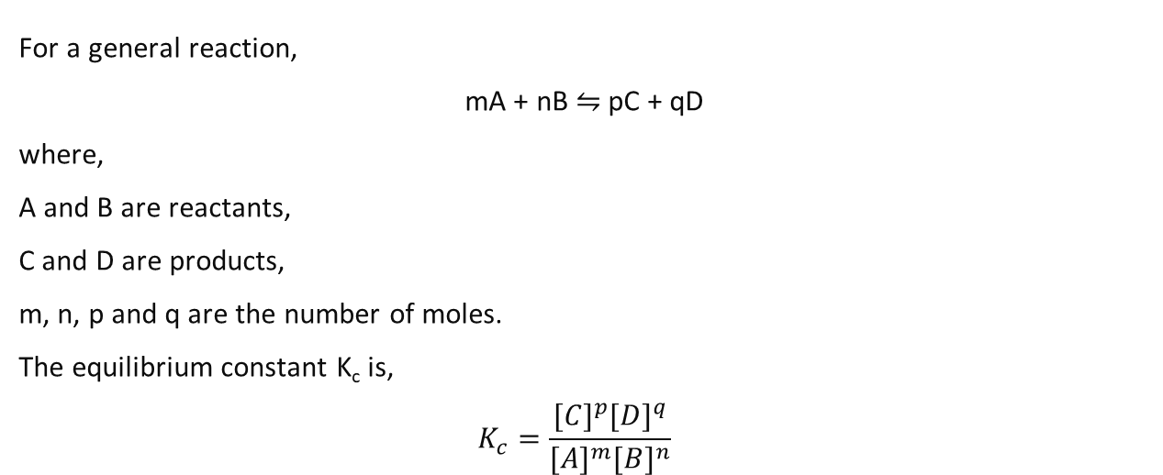
The equilibrium constant K_{c}
For a general reaction,
mA + nB ⇋ pC + qD
where,
A and B are reactants,
C and D are products,
m, n, p and q are the number of moles.
The equilibrium constant K_{c} is,
$$K_{c}=\frac{{[C]}^{p}{[D]}^{q}}{{[A]}^{m}{[B]}^{n}}$$

Slide 22
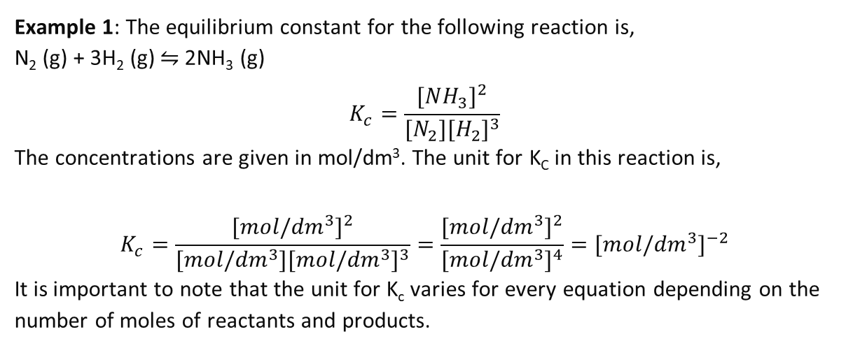
The equilibrium constant K_{c}
Example 1: The equilibrium constant for the following reaction is,
N₂ (g) + 3H₂ (g) ⇋ 2NH₃ (g)
$$K_{c}=\frac{{[NH_{3}]}^{2}}{{[N_{2}][H_{2}]}^{3}}$$
The concentrations are given in mol/dm³. The unit for K_{C} in this reaction is,
$$K_{c}=\frac{{[mol/{dm}^{3}]}^{2}}{{[mol/{dm}^{3}][mol/{dm}^{3}]}^{3}}=\frac{{[mol/{dm}^{3}]}^{2}}{{[mol/{dm}^{3}]}^{4}}={[mol/{dm}^{3}]}^{−2}$$
It is important to note that the unit for K_{c} varies for every equation depending on the number of moles of reactants and products.

Slide 23
The equilibrium constant K_{c}
Example 2: Calculate the value of equilibrium constant for the following reaction,
CH₃COCH₃ + HCN ⇋ CH₃C(OH)(CN)(CH₃)
Given that at equilibrium,
the concentration of CH₃COCH₃ is 0.0267 mol/dm³
the concentration of HCN is 0.0267 mol/dm³
the concentration of CH₃C(OH)(CN)(CH₃) is 0.0233 mol/dm³

Slide 24
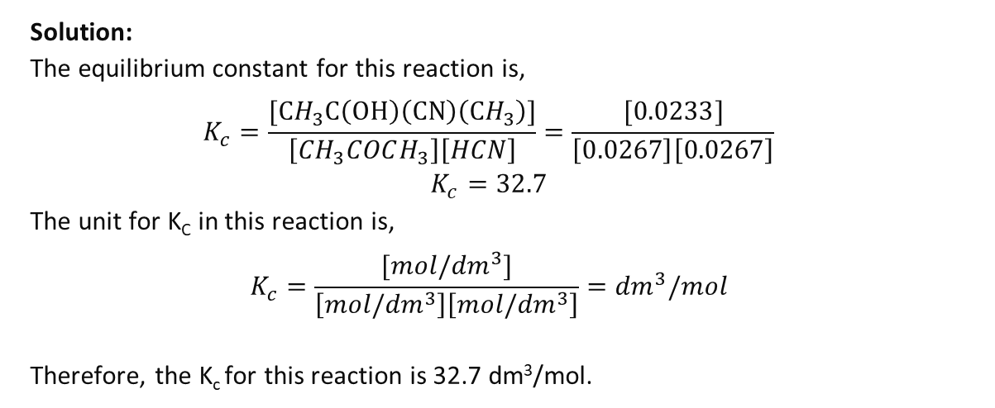
The equilibrium constant K_{c}
Solution:
The equilibrium constant for this reaction is,
$$K_{c}=\frac{[CH_{3}C\left(OH\right)\left(CN\right)\left(CH_{3}\right)]}{\left[CH_{3}COCH_{3}\right]\left[HCN\right]}=\frac{[0.0233]}{\left[0.0267\right]\left[0.0267\right]}$$
$$K_{c}=32.7$$
The unit for K_{C} in this reaction is,
$$K_{c}=\frac{[mol/{dm}^{3}]}{\left[mol/{dm}^{3}\right]\left[mol/{dm}^{3}\right]}={dm}^{3}/mol$$
Therefore, the K_{c} for this reaction is 32.7 dm³/mol.
CH₃COCH₃ + HCN ⇋ CH₃C(OH)(CN)(CH₃)
the concentration of CH₃COCH₃ is 0.0267 mol/dm³
the concentration of HCN is 0.0267 mol/dm³
the concentration of CH₃C(OH)(CN)(CH₃) is 0.0233 mol/dm³

Slide 25
The equilibrium constant K_{c}
Example 3: In a container of 500 cm³, 2.0 mol of N₂ and 4.5 mol of H₂ react together to form NH₃. At equilibrium, the concentration of NH₃ is 1.2 mol. Calculate the equilibrium constant K_{c}.
Solution:
N₂ + 3H₂ ⇋ 2NH₃
Step 1: Create a table to find the equilibrium concentration of reactants.
Using the balanced equation, if 1.2 mol of NH₃ is formed, 0.6 mol of N₂ and 1.8 mol of H₂ reacts together.
Moles of reactant at equilibrium= initial moles - moles reacted
Moles of H₂ at equilibrium = 2-0.6 =1.4 mol and moles of N₂ at equilibrium = 4.5-1.8=2.7 mol
 | N₂ | H₂ | NH₃
initial moles | 2 | 4.5 | 0
equilibrium moles | 1.4 | 2.7 | 1.2

Slide 26
The equilibrium constant K_{c}
Step 2: Find the equilibrium concentration of the reactants and products
Step 3: Finding K_{c}
$$K_{c}=\frac{{[NH_{3}]}^{2}}{{[N_{2}][H_{2}]}^{3}}=\frac{{2.4}^{2}}{2.8×{5.4}^{3}}=0.013 {[mol/{dm}^{3}]}^{−2}$$
 | N₂ | H₂ | NH₃
initial moles | 2 | 4.5 | 0
equilibrium moles | 1.4 | 2.7 | 1.2
equilibrium concentration $\left(\frac{moles}{volume}\right)$ | $$\frac{1.4}{0.5}=2.8 mol/ {dm}^{3}$$ | $$\frac{2.7}{0.5}=5.4 mol/ {dm}^{3}$$ | $$\frac{1.2}{0.5}=2.4 mol/ {dm}^{3}$$

Slide 27
Effect of changing conditions on equilibrium constant
Change in temperature:
  For an exothermic reaction, increase in temperature shifts the equilibrium to the left and hence, the equilibrium constant decreases.
  For an endothermic reaction, increase in temperature shifts the equilibrium to right and hence, increases the equilibrium constant.

Slide 28
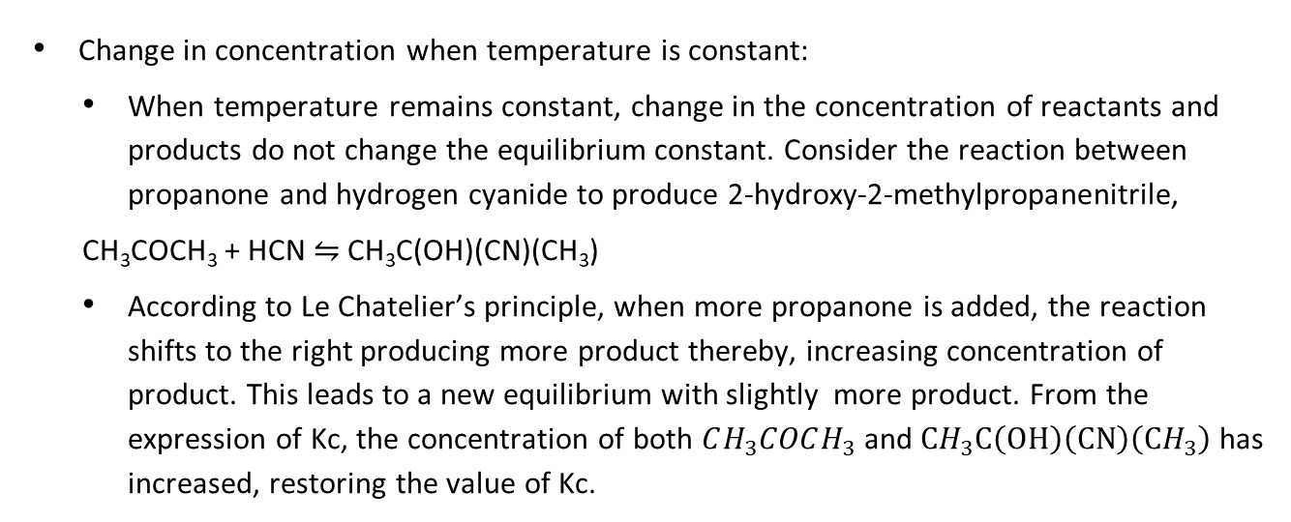
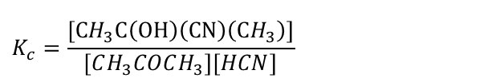
Effect of changing conditions on equilibrium constant
Change in concentration when temperature is constant:
  When temperature remains constant, change in the concentration of reactants and products do not change the equilibrium constant. Consider the reaction between propanone and hydrogen cyanide to produce 2-hydroxy-2-methylpropanenitrile,
  CH₃COCH₃ + HCN ⇋ CH₃C(OH)(CN)(CH₃)
  According to Le Chatelier’s principle, when more propanone is added, the reaction shifts to the right producing more product thereby, increasing concentration of product. This leads to a new equilibrium with slightly more product. From the expression of Kc, the concentration of both $CH_{3}COCH_{3}$ and $CH_{3}C\left(OH\right)\left(CN\right)\left(CH_{3}\right)$ has increased, restoring the value of Kc.
$$K_{c}=\frac{[CH_{3}C\left(OH\right)\left(CN\right)\left(CH_{3}\right)]}{\left[CH_{3}COCH_{3}\right]\left[HCN\right]}$$

Slide 29
Effect of changing conditions on equilibrium constant
The equilibrium constant is unaffected by change in pressure.
Presence of catalyst does not affect the value of K_{c}.
K_{C} helps in estimating the position of equilibrium.
  When the value of Kc is greater than 1, the equilibrium position favours the formation of products. When the value of Kc is less than 1, the equilibrium position favours reactants.
  Reactions with equilibrium constants greater than 10¹⁰ go to completion. Reactions with equilibrium constants less than 10⁻¹⁰ do not take place.

Slide 30
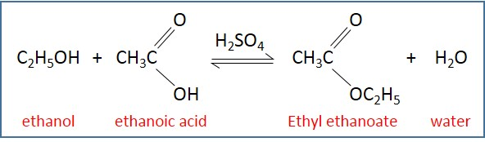
Working out the equilibrium constant
An alcohol and a carboxylic acid react in the presence of acid catalyst to form ester, which has a sweet and fruity smell.
For example: ethanol and ethanoic acid react in the presence of sulphuric acid to form ethyl ethanoate (ester) and water. This is called as esterification.
This is a reversible reaction.

Slide 31
Working out the equilibrium constant
The reaction mixture is diluted with distilled water to make a solution of 250 cm³ in a volumetric flask.
25 cm³ of this solution is then titrated against known concentration of sodium hydroxide solution with phenolphthalein indicator.
Titration is repeated until two concordant results are obtained.
The equilibrium concentrations of H⁺ ions are found.
The initial amount of moles of reactants is calculated by finding its mass,
Mass=volume × density
Moles= mass × molecular mass
Esterification takes place when reactants are mixed in a flask with a strong acid catalyst and left for several days. Stopper the flask to avoid evaporation.

Slide 32
Working out the equilibrium constant
Example 4: 0.5 mol of ethanol and 0.45 mol of ethanoic acid reacts in the presence of 6×10⁻⁴ mol of sulphuric acid for esterification reaction. At equilibrium, the reaction mixture is diluted to 250 cm³. 25 cm³ of this solution is titrated against 50 cm³ of 0.5 mol/dm³ of sodium hydroxide solution. What is the amount of ethanoic acid present at equilibrium? Also, calculate the equilibrium constant.

Slide 33
Working out the equilibrium constant
25 cm³ of this solution is titrated against 50 cm³ of 0.5 mol/dm³ of sodium hydroxide solution. 6×10⁻⁴ mol of sulphuric acid is used. What is the amount of ethanoic acid present at equilibrium?
Solution: Finding the amount of ethanoic acid,
Amount of NaOH= volume × concentration = 0.05 × 0.5 = 0.025 mol
Amount of H⁺ ions in the 25 cm³ = 0.025 mol
Hence, the amount of H⁺ ions in the 250 cm³= 0.25 mol
H⁺ ions are present due to carboxylic acid and sulphuric acid. A molecule of sulphuric acid has two H⁺ ions.
Hence, amount of ethanoic acid at equilibrium is=0.25-(2×6×10⁻⁴) = 0.249 mol

Slide 34
Working out the equilibrium constant
0.5 mol of ethanol and 0.45 mol of ethanoic acid reacts
Solution: Finding concentration of reactants and products to find out Kc,
Amount of ethanoic acid that has reacted= initial amount-amount at equilibrium = 0.45-0.249 mol=0.201 mol
Amount of ethanol at equilibrium= initial amount-amount that has reacted =0.5-0.201=0.299 mol
Amount of ethyl ethanoate at equilibrium= initial amount + amount formed= 0 + 0.201 =0.201 mol
Amount of water at equilibrium= initial amount + amount formed= 0 + 0.201 =0.201 mol

Slide 35
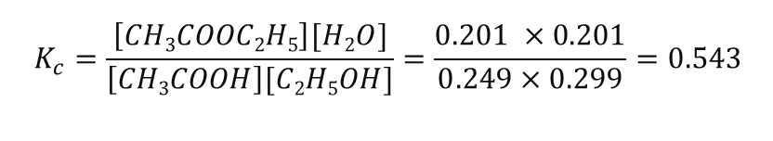
Working out the equilibrium constant
Calculate Kc
Solution: At equilibrium,
Concentration of ethanoic acid = 0.249 mol
Concentration of ethanol = 0.299 mol
Concentration of ethyl ethanoate = 0.201 mol
Concentration of water = 0.201 mol
$$K_{c}=\frac{\left[CH3COOC2H5\right][H2O]}{\left[CH3COOH\right][C2H5OH]}=\frac{0.201 ×0.201}{0.249×0.299}=0.543$$

Slide 36
Working out the equilibrium constant
To make sure that the reacting mixture has reached equilibrium, different mixtures could be made at left for different amount of time.
If the equilibrium constant is same for each of the mixture, it can be said that the time was sufficient for the reaction to reach equilibrium.

Slide 37
Working out the equilibrium constant
Example 5: One mol of ethanol reacts with one mole of ethanoic acid. If Kc=9.0, what amount of ethyl ethanoate is formed?
Solution: The initial concentrations of ethanol and ethanoic acid = 1 mol
If x moles of ethyl ethanoate was produced, the number of moles at equilibrium is given.
 | ethanol | ethanoic acid | ethyl ethanoate | water
initial moles | 1 | 1 | 0 | 0
equilibrium moles | 1-x | 1-x | x | x

Slide 38


Working out the equilibrium constant
If V is the volume of the solution,
Concentration of ethanol=concentration of ethanoic acid = mol/dm³
Concentration of ethanol= concentration of ethanoic acid = mol/dm³
$$\frac{(1−x)}{V}$$
$$\frac{x}{V}$$
 | ethanol | ethanoic acid | ethyl ethanoate | water
initial moles | 1 | 1 | 0 | 0
equilibrium moles | 1-x | 1-x | x | x

Slide 39



Working out the equilibrium constant
$$K_{c}=\frac{\frac{x}{V}×\frac{x}{V}}{\frac{(1−x)}{V}×\frac{(1−x)}{V}}=9$$
$$\frac{x2}{\left(1−x\right)2}=9$$
$$\frac{x}{\left(1−x\right)}=3$$
$$x=3−3x$$
$$4x=3$$
$$x=3/4$$
Concentration of ethanol=concentration of ethanoic acid = mol/dm³
Concentration of ethanol= concentration of ethanoic acid = mol/dm³
If ¾ moles of ethyl ethanoate is produced, ¾ moles of water is produced.
At equilibrium, the concentration of ethanol = concentration ethanoic acid= 1-3/4 = ¼ moles.
$$\frac{(1−x)}{V}$$
$$\frac{x}{V}$$

Slide 40
Working out the equilibrium constant
Example 6: The equilibrium constant for this reaction is 40 dm³/mol.
CH₃COCH₃ + HCN ⇋ CH₃C(OH)(CN)(CH₃)
This reaction is carried out in 4 dm³ of ethanol and with an initial concentration of 5.00 mol of HCN. What amount of CH₃COCH₃ is required to produce 2 mol of product?
Solution: Let x be the number of moles of CH₃COCH₃ required.
 | CH₃COCH₃ | HCN | CH₃C(OH)(CN)(CH₃)
initial moles | x | 5 | 0
equilibrium moles | x-2 | 5-2=3 | 2

Slide 41
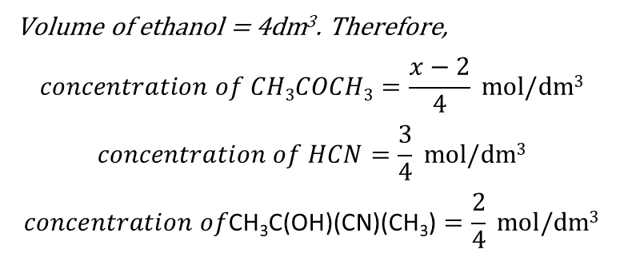
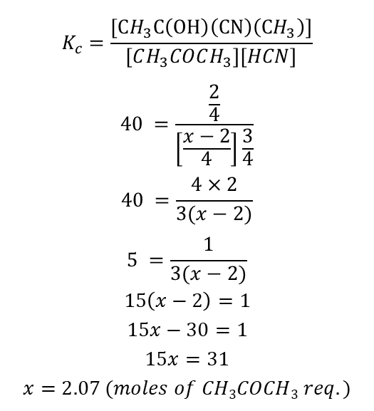
Working out the equilibrium constant
$$K_{c}=\frac{[CH_{3}C\left(OH\right)\left(CN\right)\left(CH_{3}\right)]}{\left[CH_{3}COCH_{3}\right]\left[HCN\right]}$$
$$40 =\frac{\frac{2}{4}}{\left[\frac{x−2}{4}\right]\frac{3}{4}}$$
$$40 =\frac{4×2}{3(x−2)}$$
$$5 =\frac{1}{3(x−2)}$$
$$15\left(x−2\right)=1$$
$$15x−30=1$$
$$15x=31$$
$$x=2.07 (moles of CH3COCH3 req.)$$
Volume of ethanol = 4dm³. Therefore,
$$concentration of CH3COCH3=\frac{x−2}{4} mol/dm3$$
$$concentration of HCN=\frac{3}{4} mol/dm3$$
$$concentration of\text{CH}\text{3}\text{C}\text{(}\text{OH}\text{)(}\text{CN}\text{)(}\text{CH}\text{3}\text{)}=\frac{2}{4} mol/dm3$$
 | CH₃COCH₃ | HCN | CH₃C(OH)(CN)(CH₃)
initial moles | x | 5 | 0
equilibrium moles | x-2 | 5-2=3 | 2

Slide 42
Mole fraction and partial pressure
In reactions involving gases, it is easier to measure the pressure than concentrations.
Pressure in a closed container is due to the constant bombardment of molecules against themselves and the walls of the container.
The pressure exerted by any one gas in a mixture is called partial pressure.
The pressure exerted by a gas is directly proportional to the number of moles present.
The total pressure exerted by a mixture of gases is the sum of the partial pressure of all gases that form the mixture.

Slide 43
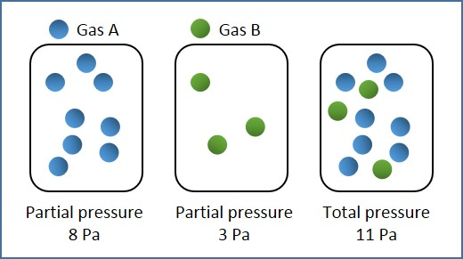
Mole fraction and partial pressure
For a mixture of two gases, the partial pressure of a gas is expressed mathematically as
Partial pressure of gas A= x₁P
where x₁ is the mole fraction of gas A.
$$mole fraction of gas A=\frac{number of moles of gas A}{total number of moles of all gases}$$
Similarly, partial pressure of gas B= x₂P
where x₂ is the mole fraction of gas B.
P=P_{A} + P_{B}
Partial pressure and total pressure

Slide 44
Equilibrium expression in terms of partial pressure
The equilibrium expression in terms of partial pressure for the reaction of nitrogen and hydrogen to form ammonia is written as
N₂ (g) + 3H₂ (g) ⇋ 2NH₃ (g)
$$K_{p}=\frac{{p_{NH_{3}}}^{2}}{{p_{N_{2}}×p_{H_{2}}}^{3}}$$
The units of pressure is Pascals (Pa). The unit of K_{p} depends on the expression of K_{p}.
In this example of the production of ammonia, the units of K_{p} are
$$K_{p}=\frac{{Pa}^{2}}{{Pa×Pa}^{3}}={Pa}^{−2}$$

Slide 45
Equilibrium expression in terms of partial pressure
Example 5: Consider the following reaction,
2SO₂ (g) + O₂ (g) ⇋ 2SO₃ (g)
2 mol of SO₂ and 1 mol of O₂ are added together and the mixture is allowed to reach equilibrium. At equilibrium 30% of SO₂ has reacted. If the total pressure is 8×10⁶ Pa, calculate the value of K_{p} for this reaction.
Solution:
Step 1: Finding the number of moles at equilibrium,
 | SO₂ | O₂ | SO₃
initial moles | 2 | 1 | 0
equilibrium moles | 1.4 | 0.7 | 0.6

Slide 46
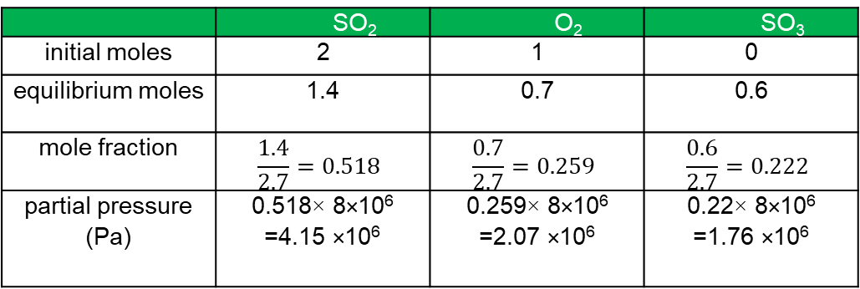
Equilibrium expression in terms of partial pressure
Number of moles at equilibrium for SO₂ = initial moles - moles reacted=2-(0.3×2) = 1.4 mol
Number of moles at equilibrium for O₂ = initial moles - moles reacted=1-(0.3×1) = 0.7 mol
Number of moles at equilibrium for SO₃ = initial moles + moles formed= (0.3×2) = 0.6 mol
Step 2: Finding the partial pressures of all gases,
 | SO₂ | O₂ | SO₃
initial moles | 2 | 1 | 0
equilibrium moles | 1.4 | 0.7 | 0.6
mole fraction | $$\frac{1.4}{2.7}=0.518$$ | $$\frac{0.7}{2.7}=0.259$$ | $$\frac{0.6}{2.7}=0.222$$
partial pressure (Pa) | 0.518× 8×10⁶ =4.15 ×10⁶ | 0.259× 8×10⁶ =2.07 ×10⁶ | 0.22× 8×10⁶ =1.76 ×10⁶

Slide 47
Equilibrium expression in terms of partial pressure
Step 3: Calculating Kp,
$$K_{p}=\frac{{p_{SO_{3}}}^{2}}{{p_{O_{2}}×p_{{SO}_{2}}}^{2}}=\frac{{(1.76 ×{10}^{6})}^{2}}{2.07×{10}^{6}×{(4.15 ×{10}^{6})}^{2}}=8.689×{10}^{−8} {Pa}^{−1}$$
Heterogeneous equilibria for K_{p}:
When a reaction contains reactants and products of different states, the substances other than gases are left out in the expression for K_{p}.
For example:
3Fe(s) + 4H₂O (g) ⇋ Fe₃O₄ (s) + 4H₂ (g)
$$K_{p}=\frac{{p_{H_{2}}}^{4}}{{p_{H_{2}O}}^{4}}$$

Slide 48
Equilibrium constants and changes in condition
The larger the value of Kc, the more favourable it is for the formation of products.
A lower K_{c} denotes that the reaction is more favourable towards the formation of reactants.
The effect of changing concentration, temperature and pressure on equilibrium constants is important.
It is also important to note that the equilibrium constants K_{c} and K_{p} change only with changes in temperature.
They remain unchanged with changes in concentration and pressure.

Slide 49
Equilibrium constants and changes in temperature
For endothermic reactions, the increase in temperature favours the formation of products. The equilibrium shifts to the right. For this endothermic reaction,
2HI⇋ H₂ + I₂
the equilibrium constant is,
$$K_{c}=\frac{\left[H_{2}\right]\left[I_{2}\right]}{{[HI]}^{2}}$$
When temperature is increased, the reaction shifts to the right forming more products. As a result, the value of K_{c} increases.
The equilibrium constant in terms of partial pressure is,
$$Kp=\frac{p_{H_{2}}×p_{I_{2}}}{p_{HI}^{2}}$$
When temperature is increased, the mole fraction of products (H₂ and I₂) increases. As a result, the value of K_{p} increases.

Slide 50
Equilibrium constants and changes in temperature
For exothermic reactions, the increase in temperature shift the reaction towards the left. For this exothermic reaction,
2SO₂ (g) + O₂ (g) ⇋ 2SO₃ (g)
the equilibrium constant is,
$$K_{c}=\frac{{\left[{SO}_{3}\right]}^{2}}{{{[SO}_{2}]}^{2}\left[O_{2}\right]}$$
When the temperature increases, the concentration of SO₂ and O₂ increases and the concentration of SO₃ decreases, the value of K_{c} decreases.

Slide 51
Equilibrium constants and changes in concentration
Changing concentration of reactants or products shifts the position of equilibrium but the value of equilibrium constant remains the same.
For example, when the concentration of hydrogen iodide is increased in the following reaction,
2HI⇋ H₂ + I₂
the equilibrium is restored by increasing the concentration of hydrogen and iodine. Thus, the value of K_{c} remains constant

Slide 52
Equilibrium constants and changes in pressure
Changes in pressure shift the position of equilibrium but the values of equilibrium constants K_{c} and K_{p} remain unchanged. Consider the reaction,
N₂ + 3H₂ ⇋ 2NH₃
When the pressure is increased at constant temperature, the equilibrium shifts towards the right where there are fewer molecules. The concentration of NH₃ increases and the concentration of N₂ and H₂ decreases.
Therefore, the equilibrium constant,
$K_{c}=\frac{{\left[{NH}_{3}\right]}^{2}}{{[H_{2}]}^{3}\left[N_{2}\right]}$
remains the same as the numerator increases but the denominator decreases.

Slide 53
Equilibrium constants and changes in pressure
The equilibrium constant K_{p} remains unchanged. This is because the mole fraction of NH₃ increases but the mole fraction of N₂ and H₂ decreases.
$$K_{p}=\frac{{p_{NH_{3}}}^{2}}{{p_{N_{2}}×p_{H_{2}}}^{3}}=\frac{{x_{NH_{3}}}^{2}P}{{x_{N_{2}}P×x_{H_{2}}}^{3}P}$$
As a result, the value of K_{p} is restored.

Slide 54
Definitions of acids
Acids are chemical substances that release hydrogen ions (H⁺) when added to aqueous solutions.
HCl (g) + H₂O (l) → H₃O⁺ (aq) + Cl- (aq)
H+ ion datively bonds with water molecule to form oxonium ion, H₃O⁺ ion (hydroxonium ion). This ion also form hydrogen bonds with water molecules.
H⁺ (aq) + H₂O (l) → H₃O⁺ (aq)
Strong acid is fully dissociated in aqueous solution. Some examples of strong acids are HCl, H₂SO₄ and HNO₃.

Slide 55
Definitions of acids
A weak acid is only dissociated to a small extent in aqueous solution. An example of weak acid is ethanoic acid (CH₃COOH). Less than 10% of the hydrogen atoms are ionised.
CH₃COOH (l) + H₂O (l) ⇋ H₃O⁺ (aq) + CH₃COO- (aq)
Chemical name | Chemical formula | Ions formed in water
Hydrochloric acid | HCl | hydrogen ion and chloride ion
Sulphuric acid | H₂SO₄ | two hydrogen ions and sulphate ion
Nitric acid | HNO₃ | hydrogen ion and nitrate ion
Ethanoic acid | CH₃COOH | hydrogen ion and ethanoate ion (CH₃COO⁻)

Slide 56
Definitions of bases
A base is a substance that reacts with an acid. An alkali is a base that is soluble in water. Examples of alkalis include group 1 hydroxides, soluble group 2 hydroxides, ammonia and soluble organic amines. Bases are chemical substances that release hydroxide ions (OH⁻) when added to aqueous solutions.
NaOH (aq) → Na⁺ (aq) + OH- (aq)
Some alkalis when dissolved in water, accept hydrogen ions and releases hydroxide ion. Ammonia is such an example.
NH₃ (aq)+ H₂O (l) ⇋ NH₄⁺ (aq) + OH- (aq)

Slide 57
Definitions of bases
Chemical name | Chemical formula | Ions formed in water
Sodium hydroxide | NaOH | sodium ion and hydroxide ion
Potassium hydroxide | KOH | potassium ion and hydroxide ion
Ammonia | NH₃ | ammonium ion and hydroxide ion

Slide 58
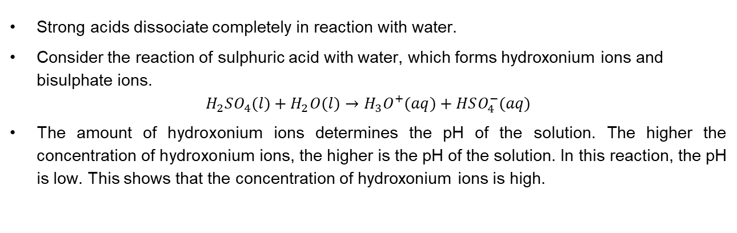
Strong acids
Strong acids dissociate completely in reaction with water.
Consider the reaction of sulphuric acid with water, which forms hydroxonium ions and bisulphate ions.
$$H_{2}SO_{4}(l)+H_{2}O(l)→H_{3}O^{+}(aq)+HSO_{4}^{−}(aq)$$
The amount of hydroxonium ions determines the pH of the solution. The higher the concentration of hydroxonium ions, the higher is the pH of the solution. In this reaction, the pH is low. This shows that the concentration of hydroxonium ions is high.

Slide 59
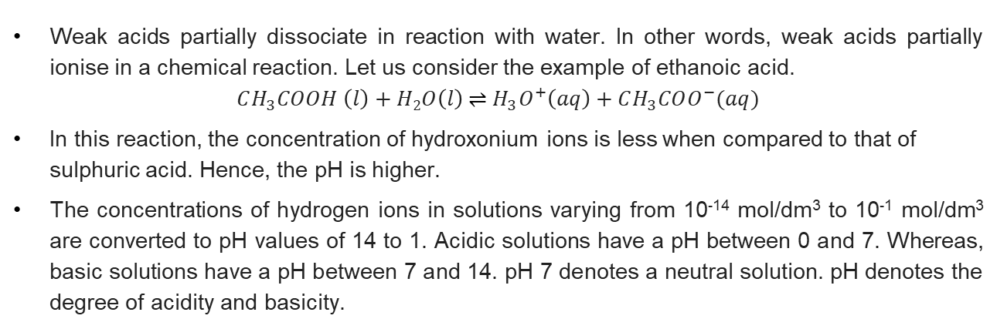
Weak acids
Weak acids partially dissociate in reaction with water. In other words, weak acids partially ionise in a chemical reaction. Let us consider the example of ethanoic acid.
$$CH_{3}COOH \left(l\right)+H2O\left(l\right) \text{⇌} H_{3}O^{+}\left(aq\right)+CH_{3}COO^{−}(aq)$$
In this reaction, the concentration of hydroxonium ions is less when compared to that of sulphuric acid. Hence, the pH is higher.
The concentrations of hydrogen ions in solutions varying from 10⁻¹⁴ mol/dm³ to 10⁻¹ mol/dm³ are converted to pH values of 14 to 1. Acidic solutions have a pH between 0 and 7. Whereas, basic solutions have a pH between 7 and 14. pH 7 denotes a neutral solution. pH denotes the degree of acidity and basicity.

Slide 60
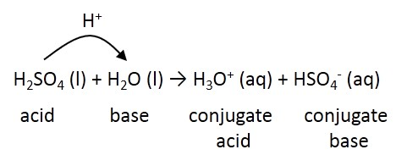
Bronsted-Lowry acids and bases
The definition for Bronsted-Lowry acids and bases is based on the fact that in a reaction between an acid and a base, the proton (H+ ion) is transferred from acid to base.
Thus, a Bronsted-Lowry acid is a proton-donor and a Bronsted-Lowry base is a proton-acceptor.
If a reactant is related to product by transfer of a proton, then the pair is called as conjugate pair.
In the above reaction, HSO₄⁻ is the conjugate base of acid H₂SO₄ and H₃O⁺ is the conjugate acid of base H₂O.

Slide 61
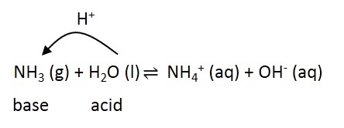
Bronsted-Lowry acids and bases
Ammonia is an example of base, which reacts with water and accepts the proton to form ammonium and hydroxide ions.
It is important to note that ammonia is a weak base, and it dissociates partially.
In the above reaction, NH₄⁺ is the conjugate acid of base NH₃ and OH⁻ is the conjugate base of acid H₂O.

Slide 62
Bronsted-Lowry acids and bases
Acid which donates one hydrogen ion is called as monobasic acid. For example: hydrochloric acid.
Acid which donates two hydrogen ions is called as dibasic acid. For example: sulphuric acid.
Acid which donated three hydrogen ions is called as tribasic acid. For example: phosphoric acid.

Slide 63
Reaction of acids with metals and metal oxides
Acids react with metals to form salt and releases hydrogen gas.
Metal + acid → Salt + hydrogen
Mg + 2HCl →MgCl₂ + H₂
The protons react with metal to form metal ion and hydrogen.
2H⁺ + Mg → Mg²⁺ + H₂
When metal oxide reacts with acid, the metal ion replaces the H⁺ ions to form salt. The H⁺ and OH⁻ ions react together to form water.
Metal oxide + acid → Salt + water
MgO + 2HCl →MgCl₂ + H₂O
The H⁺ ion in HCl is replaced by the metal ion (Mg²⁺) and a salt (MgCl₂) is formed. The H⁺ and OH⁻ ion combine to form H₂O.
H⁺ + OH⁻→H₂O

Slide 64
Reaction of acids with carbonates
When metal carbonate reacts with acids, the metal ion replaces the H⁺ ions to form salt.
The H⁺ and OH⁻ ions react together to form water. In addition to salt and water, carbon dioxide gas is also released.
Metal carbonate + acid → Salt + water + carbon dioxide
Let us consider the reaction of calcium carbonate and hydrochloric acid,
CaCO₃ + 2HCl → CaCl₂ + H₂O + CO₂
The H⁺ ion in HCl is replaced by the metal ion (Ca²⁺) and a salt (CaCl₂) is formed. In this reaction, water is produced, and carbon dioxide gas is released.
2H⁺ + CO₃²⁻→H₂O + CO₂

Slide 65
Reaction of acids with alkali
When metal hydroxide reacts with acid, the metal ion replaces the H⁺ ions to form salt. The H⁺ and OH⁻ ions react together to form water.
Let us consider the reaction of hydrochloric acid and sodium hydroxide,
HCl + NaOH → NaCl +H₂O
The H⁺ ion in HCl is replaced by the metal ion (Na⁺) and a salt (NaCl) is formed. The H⁺ and OH⁻ ion combine to form H₂O.
H⁺ + OH⁻→H₂O

Slide 66
Indicators used in titration
Indicator is used in titration to identify the end-point of neutralisation. Indicators are weak acids where the acid (HA) and its conjugate base (A⁻) have different colours.
HA ⇋ H⁺ + A⁻
The colour of the indicator over a range of pH but a distinct colour change is observed at the middle of this range, which is called as the end-point.
For example: the colour change for phenolphthalein (colourless when acidic and pink when alkaline) occurs at a range 8.2-10.0 but the end-point, that is, the pink colour is observed at pH value of 9.3.
.
Indicator | Initial colour of indicator | pH range | End-point | Colour change
bromothymol blue | yellow | 6-7.6 | 7.0 | blue
phenolphthalein | colourless | 8.2-10.0 | 9.3 | pink
methyl red | red | 4.2-6.3 | 5.1 | yellow

Slide 67
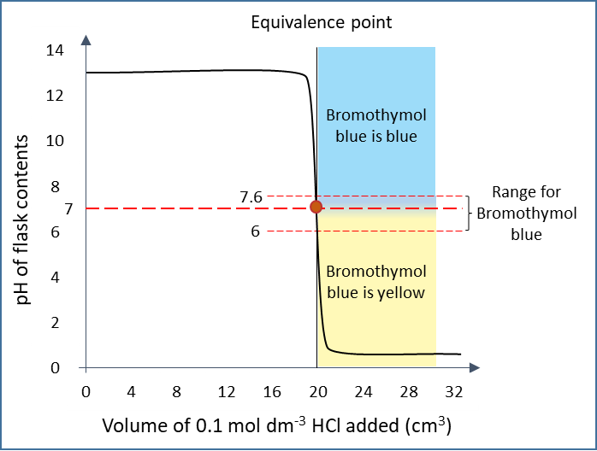
Neutralisation: Strong acid with strong bases
When a strong alkali is titrated with a strong acid, indicators such a bromothymol blue or phenolphthalein is used.
For example: the titration of 0.1 mol/dm³ sodium hydroxide is with 0.1 mol/dm³ hydrochloric acid.
Due to the addition of hydrogen ions into the strong alkali, there is a rapid change of pH from 10.5 to 3.5.
The range of colour change of bromothymol indicator is 6.0-7.6, where the slope of pH curve is the steepest.
At pH 7, which is the midpoint of this range, the hydrogen ions have exactly neutralised the hydroxide ions.
As the pH change exists over a wide range, other indicators such as phenolphthalein is also used.
.
pH curve of titration using bromothymol indicator

Slide 68
Equivalence point
The point in a titration at which the reaction is just complete is called equivalence point.
In other words, equivalence point is the point at which sufficient acid (or base) is added to neutralise base (or acid).
In the above titration, equivalence point is reached after adding 20 cm³ of acid to base at a pH of 7.
Always choose an indicator so that pK_{in} is not more than 1 unit from the equivalence pH.
For example, if the equivalence pH is 7.0, the pK_{in} of indicator should be between 6.0 and 8.0.
pH curve of titration using bromothymol indicator

Slide 69
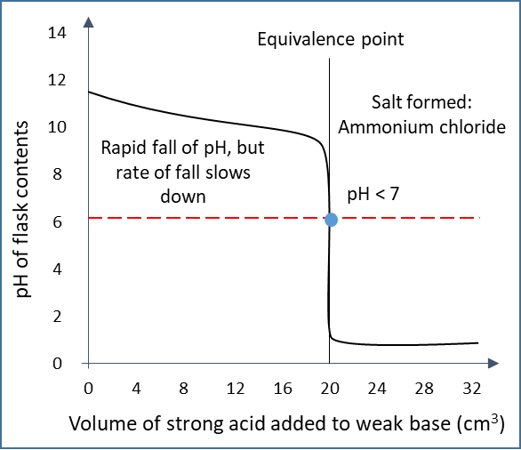
Neutralisation: Strong acid with weak bases
The pH curve when a 0.100 mol/ dm³ of ammonia is titrated with 0.100 mol/dm³ of HCl is shown in figure.
The pH changes sharply over a range of 1.0 to 7.5.
In this case, indicators such as phenolphthalein cannot be used as its colour change does not occur at this range.
However, methyl red which changes colour between a pH of 4.2 and 6.3 can be used.
pH curve when a weak base is titrated with a strong acid

Slide 70
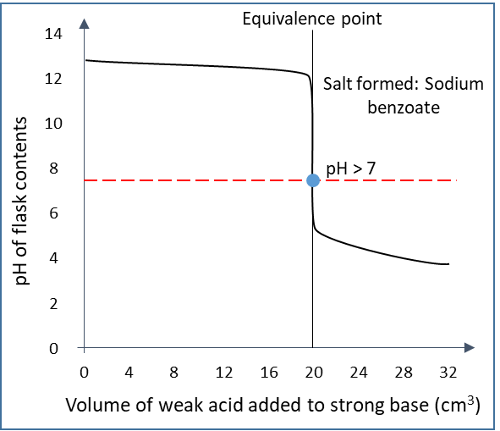
Neutralisation: Weak acids with strong bases
The pH curve when a strong base (0.1 mol/dm³ of NaOH) is titrated with a weak acid (0.1 mol/dm³ of benzoic acid) is shown in the figure.
The pH changes sharply over a range of 5.5-11.
The suitable indicator for this case is phenolphthalein.
pH curve when a strong base is titrated with a weak acid

Slide 71
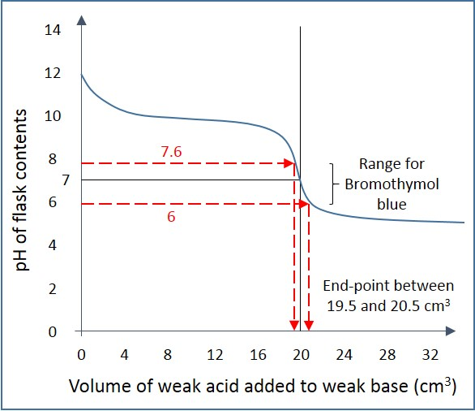
Neutralisation: Weak acids with weak bases
The pH curve when a weak base (0.1 mol/dm³ of NH₃) is titrated with a weak acid (0.1 mol/dm³ of CH₃COOH) is shown in the figure below.
There is no sharp change in pH.
Therefore, no indicator is suitable to detect the exact point where the hydrogen ions have neutralised the hydroxide ions.
The colour change would be gradual, and the readings would not be accurate.
Till the equivalence point, this graph looks like NH₃-HCl graph and after the equivalence point, this graph looks like CH₃COOH-NaOH graph.
pH curve when a weak base is titrated with a weak acid

Slide 72
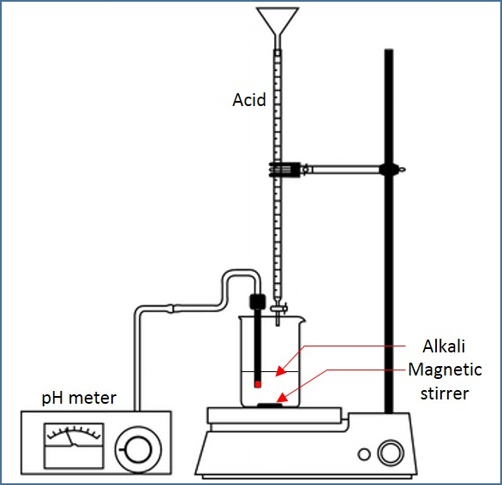
Measuring pH with pH meter
Titration experiments can also be performed using a pH meter instead of using an indicator.
The value of pH over the volume of acid is used to plot the pH curve and find the exact volume of acid required to neutralise the base.
The steps to be followed while measuring the pH using pH meter are:
Set up the apparatus for titration as shown in figure.
Connect the pH electrode to a data logger.
Switch on the magnetic stirrer.
Add the acid to the alkali slowly.
Stop when the pH value reaches a constant low value.
Construct the pH curve.
Measuring pH with pH meter

